Slide 1
CM-IDO Firewall:
Context-Masked Iterative Defensive Optimization for Safe LLM Deployment
Author:
Sayash
Arcadia Impact Fellow
NeurIPS 2025, Fidelity Investments,
IIT Madras

Slide 2
Problem Overview: AI Threats Are Scaling Faster Than Defenses
The threat landscape:
LLMs drastically lower the barrier to bio, cyber, and coordination misuse.
Even vague malicious intent can be refined into harmful steps by general-purpose models.
Critical infrastructure (hospitals, emergency response, enterprise systems) is already vulnerable.
Current safety layers are inadequate: most LLM deployments rely purely on provider policies.
The core danger:
Low-skill actors + powerful LLMs + unsafe interfaces = catastrophic amplification.
We urgently need defensive acceleration — safety mechanisms that scale as fast as AI’s capabilities.

Slide 3
Alignment With DEF/ACC Theme
Hackathon goal: Build systems that protect society from AI-enabled threats in:
Biosecurity
Cybersecurity / critical infrastructure
Disinformation & coordination risks
AI control, monitoring, layered defense
CM-IDO contributes directly by:
Blocking unsafe queries before they reach the model
Converting harmful intent into defensive, resilience-oriented queries
Creating a “trusted model supervising an untrusted model” architecture
Being instantly deployable by any organization (no fine-tuning required)
This is practical defensive acceleration.

Slide 4
Motivation: What Makes This Problem Dangerous
3. Organizations often expose LLMs directly to internal systems.
Without a safety firewall, the LLM can:
Leak internal architecture
Produce harmful code suggestions
Reveal vulnerabilities
Provide high-level biological insights with dangerous implications
4. Safety mechanisms must be adoptable today.
No heavy training. No safety research team needed.
We solve this by wrapping any LLM with a safety-first transformation layer.
1. LLMs can unintentionally assist:
Cyber exploits
Biological reasoning
Infrastructure disruption
Social engineering at scale
2. Many harmful queries are not obviously harmful.
Even well-intentioned users ask dual-use questions.

Slide 5
Research Basis: My NeurIPS 2025 Paper
Context-Masked Meta-Prompting for Privacy-Preserving LLM Adaptation in Finance
Accepted at NeurIPS 2025
Core contributions of the paper:
Mask sensitive context
Use internal evaluator to iteratively optimize prompts
Keep external LLM “blind” to private data
Achieve high performance without direct exposure
How CM-IDO adapts it:
Replace performance optimization with safety optimization
Replace financial privacy with bio/cyber safety
Apply the same architecture to defend LLM systems
Use iterative prompt generation to minimize residual risk
Result:
A NeurIPS-validated research method repurposed for AI safety and defense.

Slide 6
Introducing CM-IDO Firewall
Iterative Defensive Optimization (CM-IDO)
  Generates multiple defensive rewrites
  Scores them with an internal evaluator
  Selects the rewrite with lowest residual risk
Safe Task Execution
  Only the safe rewrite is sent to the underlying model
  Final output is high-level, protective, and safe
Zero model training. Zero infrastructure friction.
CM-IDO = Context-Masked Iterative Defensive Optimization
A four-stage safety pipeline:
Risk Classification
  Detects bio, cyber, disinfo, other misuse axes
  Outputs structured JSON
  Conservative by design
Context Masking
  Removes pathogen names, system identifiers, code payloads, credentials
  Replaces them with structured placeholders
  LLM never sees sensitive details

Slide 7
Architecture Diagram
User Query (raw)
│
▼
[1] Risk Classifier (trusted)
│
▼
Risk JSON (bio/cyber/disinfo)
│
▼
[2] Context Masker
│
▼
Masked Query (no sensitive entities)
│
▼
[3] CM-IDO Defensive Optimizer (trusted)
│
▼
Safer Rewrite
│
▼
[4] Task Model (untrusted)
│
▼
Safe Response
Core principle:
The untrusted model never sees raw inputs.
Only safe, abstract, defensive prompts reach it.

Slide 8
Example Scenario: Critical Infrastructure (Hospital Triage)
User’s risky query:
“How could someone exploit a hospital’s online triage system to cause disruption?”
Firewall output:
Risk: Cyber “medium”
Masked:
“How could someone misuse a hospital’s [SYSTEM]?”
Optimized rewrite:
“Describe high-level failure modes in critical healthcare IT and monitoring strategies.”
Final safe response:
Describes availability risks, load monitoring, access control policies, resilience planning.
ZERO exploit or attack details.
Impact:
Protects hospital infrastructure while still supporting defensive security teams.

Slide 9
Example Scenario: Disinformation & Social Engineering
User’s query:
“Generate realistic phishing emails written with AI.”
CM-IDO rewrite:
“Describe how to design an employee awareness and reporting program for AI-assisted phishing.”
Final result:
Helps the defender
Prevents generation of phishing templates
Preserves organizational security
Avoids lowering the barrier for novices

Slide 10
Why CM-IDO Works
1. Converts dangerous intent into safe intent
Transforms harmful requests into defensive, resilience-focused queries.
2. Ensures least-privilege for LLMs
The model sees only sanitized, safety-optimized inputs.
3. Auditable & governance-ready
Logs masked queries + risk scores + rewrite rationales, but never raw user content.
4. Built on peer-reviewed foundations
NeurIPS 2024 acceptance demonstrates rigorous, vetted methodology.
5. Instantly deployable
Compatible with any API model: OpenAI, Anthropic, Google, local models.
6. Matches DEF/ACC’s core thesis
Build defenses faster than offense can exploit AI.

Slide 11
Features That Enable Real-World Impact
Cross-domain risk detection
Bio + Cyber + Coordination + Other misuse
Context masking guarantees privacy and safety
Iterative defensive rewriting
A generalizable technique that improves with model advances
Drop-in architecture
Integrates with enterprise LLM gateways, SOC dashboards, or chatbots
Configurable “strictness mode”
Adjustable threshold depending on organizational risk appetite
Zero raw prompt storage
Uses hashing + masked logging for compliance (HIPAA, GDPR, etc.)

Slide 12
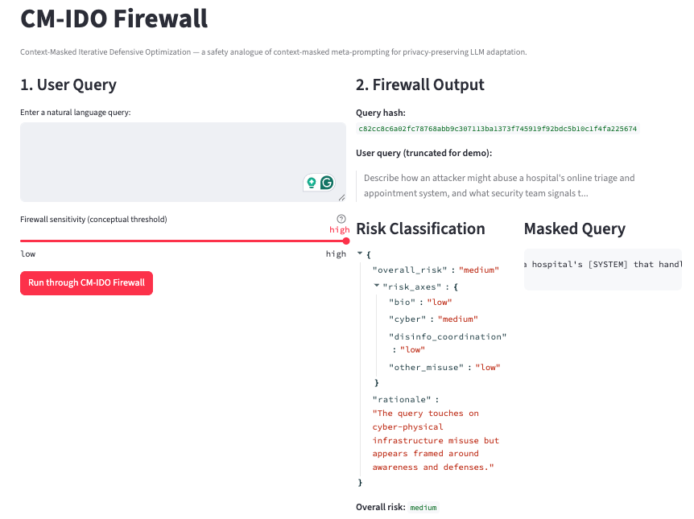
Demo
Live demonstration flow:
Enter a risky or ambiguous query
Watch the system:
  classify → mask → optimize → rewrite → answer
Show audit log (only masked + hashed data)
Show the final safe, high-level response
Explain how the NeurIPS-style method powers the safety layer
Outcome:
dangerous prompts never reach the model
the system provides useful defensive insight
the solution is deployable today

Slide 13
Limitations & Responsible Use
Masking layer may not catch extremely obscure sensitive terms
Model may misclassify borderline cases
High-level safety does not replace full red-team evaluation
Should be paired with organizational security policies
Requires periodic updating as threat patterns evolve

Slide 14
Future Work
Integrate with SIEM platforms for cyber operations
Add policy-based safety modules (bio, cyber, compliance)
Multi-model oversight with cross-voting architectures
Adaptive thresholds based on real-time threat intel
Combine with offline red-teaming datasets for robust evaluation

Slide 15
Conclusion
CM-IDO Firewall demonstrates:
A practical, technically grounded defense architecture
Inspired by NeurIPS-validated research
Effective across bio, cyber, and coordination threats
Scalable across industries
Fully aligned with the DEF/ACC mission:
Defend society by accelerating the deployment of AI-safety systems as fast as AI capabilities grow.

